Slide 1

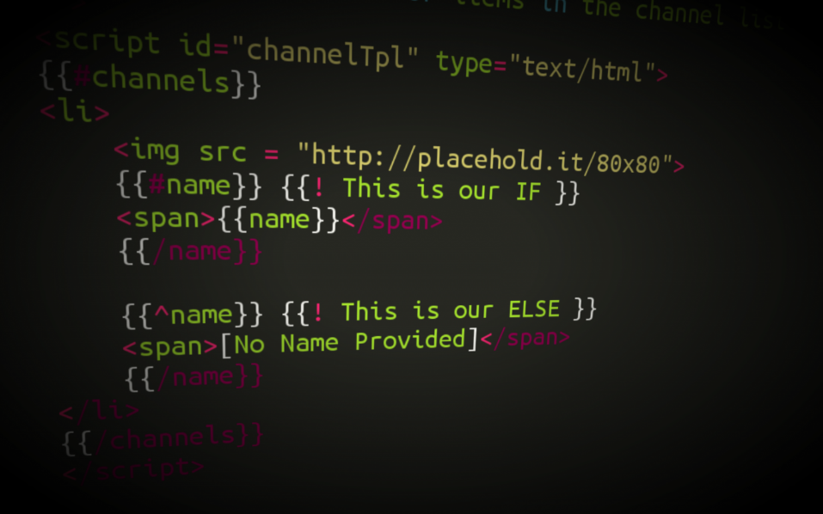


Unit Testing in JavaScript
with Mocha, Chai and Karma
SoftUni Team
Technical Trainers
Software University
http://softuni.bg

Slide 2
Table of Contents
Unit Testing
Overview
Test-driven & behavior-driven development
Mocha & Chai
Overview and installation
Running simple tests
Mocha HTML Reporter and Karma
Creating a test suites and specs

Slide 3

What is Unit Testing?

Slide 4
Unit Test – Definition
A unit test is a piece of code written by a developer that exercises a very small, specific area of functionality of the code being tested.
“Program testing can be used to show the presence of bugs, but never to show their absence!”
Edsger Dijkstra, [1972]

Slide 5

Manual Testing
You have already done unit testing
Manually, by hand
Manual tests are less efficient
Not structured
Not repeatable
Not on all your code
Not easy to do as it should be

Slide 6
Unit Test – Example
function sum(numbers) {
var sum = 0;
for (var i = 0; i < numbers.length; i++) {
sum += array[i];
}
return sum;
}
void testSum() {
if (sum([1,2]) != 3) throw new Error("1+2 != 3");
if (sum([-2]) != -2) throw new Error("-2 != -2");
if (sum([]) != 0) throw new Error("0 != 0");
}

Slide 7
Unit Testing – Some Facts
Tests are specific pieces of code
In most cases unit tests are written by developers, not by QA engineers
Unit tests are released into the code repository (TFS / SVN / Git) along with the code they test
Unit testing framework is needed
QUnit, Jasmine, Mocha

Slide 8
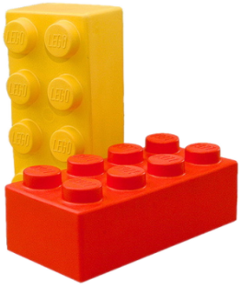
Unit Testing – More Facts
All objects should be tested
All methods should be tested
Trivial code may be omitted
E.g. property getters and setters
Private methods can be omitted
Some gurus recommend to never test private methods → this can be debatable
Ideally all unit tests should pass before check-in into the source control repository

Slide 9

Why Unit Tests?
Unit tests dramatically decrease the number of defects in the code
Unit tests improve design
Unit tests are good documentation
Unit tests reduce the cost of change
Unit tests allow refactoring
Unit tests decrease the defect-injection rate due to refactoring / changes

Slide 10
Unit Testing in JavaScript

Slide 11
Unit Testing in JavaScript
There are too many frameworks for unit testing for JavaScript
Some use TDD
Others use BDD
Some of the frameworks:
TDD
QUnit, JsUnit & Mocha
BDD
Jasmine & Mocha

Slide 12
QUnit
QUnit was developed to test jQuery
Developed by John Resig
QUnit has the following features:
Uses test-driven development (TDD)
Has a lot of asserts to match every need
Can test async code

Slide 13
Jasmine
Jasmine is an open-source testing framework
Can run in both the browser and on Node.js
Uses behavior-driven development
Widely used
Introduces in 2008
Jasmine has the following features:
Easy-to-read (expressional) syntax
Testing async code
Spies (mocking objects and methods)
DOM testing

Slide 14
Mocha
Mocha is the new kid on the block
Open source framework, introduces in 2012
Can run in both the browser and on Node.js
Plugins for test syntax, spies, etc…
Mocha has the following features:
Easy-to-read (expressional) syntax
Testing async code
Supports both BDD and TDD
The most used plugin for syntax is Chai.js
The most used plugin for spies is Sinon

Slide 15
Testing with Mocha
Overview and Installation

Slide 16
Mocha Overview
Mocha is a feature-rich framework for testing JavaScript
Run in both the browser and on Node.js
Can test async code
Compatible with Karma & other test runners
Pluggable
Different plugins to add even more features

Slide 17
Installing Mocha
To start working with Mocha follow the steps:
Get Mocha
Download mocha from GitHub
With bower
With NuGet
Setup a reporter
HTML reporter
Karma reporter
$ bower intall mocha
PM> Install-Package MochaChaiBdd

Slide 18
Installing Mocha
To start working with Mocha follow the steps:
Select a plugin for the test syntax
Mostly used is chai.js
Start writing tests
$ bower intall chai
describe('#sum', function () {
it('when empty array, expect to return 0', function () {
var actual = sum([]);
expect(actual).to.equal(0);
});
it('when with single number, expect the number', function () {
var number = 6;
var actual = sum([number]);
var expected = number;
expect(actual).to.equal(expected);
});
});

Slide 19
Running Tests with Mocha and Chai
Live Demo

Slide 20
Mocha with Chai
Adding assertion framework

Slide 21
Mocha with Chai
Mocha is made pluggable
Can use almost any assertion framework
The most used is Chai.js
Chai.js uses behavior-driven development
To use Chai in Mocha, do the following:
Install Chai:
Add chai.js to your reporter
Set the global expect object to chai.expect
$ bower install chai
<script src="…/chai.js">
expect = chai.expect;

Slide 22
Mocha Reporters
Where Mocha can report the result of the tests?

Slide 23
Mocha Reporters
What is a reporter?
Reporter is the place where Mocha outputs the result from the unit tests
If the tests passed
Or if they failed
Mocha has a lot of reporters:
http://visionmedia.github.io/mocha/#reporters
Good reporters are the HTML reporter, the Spec reporter and the Karma reporter

Slide 24
Mocha HTML Reporter
The HTML reporter outputs in the browser
Needs an HTML template:
<!-- document start -->
<head>
<link rel="stylesheet" href="mocha/mocha.css" />
</head>
<body>
<div id="mocha"></div>
<!-- include mocha.js and chai.js -->
<script type="text/javascript">
mocha.setup('bdd');
expect = chai.expect;
</script>
<!-- import javascript files and test files -->
<script type="text/javascript">
mocha.run();
</script>
<!-- document end -->
1. Include the Mocha styles
2. Create report element with id mocha
3. Include mocha.js and chai.js
4. Setup Mocha
5. Import JS files
6. Run tests with Mocha

Slide 25
Mocha HTML Reporter
Live Demo

Slide 26
Mocha Test Suites and Specs

Slide 27
Mocha Test Suites
Mocha uses test suites to order the tests
Tests suites are created with the describe(name, callback) function
Provide a name of the test suite and a callback function
Test suites can be nested in one another
describe('#sum', function() {
//here are the tests
});
describe('Person', function() {
describe('when initializing', …
describe('when changing name', …
});

Slide 28
Mocha Specs
Specs (tests) are contained in a test suites
Call the function it(name, callback)
Has a name and a callback:
describe('Person', function() {
describe('when initializing', function(){
it('with valid names, expect ok', function(){
var person = new Person('Peter', 'Petrov');
expect(person.firstname()).to.equal('Peter');
expect(person.lastname()).to.equal('Petrov');
});
});
});

Slide 29
Mocha Test Suites and Tests
Live Demo

Slide 30
Chai Assertions
How to use Chai.js?

Slide 31
Chai Assertions
Chai.js is a assertion framework
Allows to assert expected/actual in tests
Chai.js has three assertion styles
Assert style
Expect style
Should style
assert.equal(person.firstname(), 'Peter');
expect(person.firstname()).to.equal('Peter');
person.firstname().should.equal('Peter');

Slide 32
Chai Expect Assertion Style
Using the BDD Styles

Slide 33
Chai Expect Assertion Style
Chai.js expect assertion style has a fluent and expressive syntax:
expect(person.firstname()).to.equal('Peter');
expect(person).to.be.a('Person');
expect(person).to.not.be.undefined;
expect(person).not.to.be.null;
expect(person).to.be.ok;
expect(person).not.to.be.ok;
expect(function(){
// without name
new Person();
}).to.throw(ReferenceError);

Slide 34
Chai Assertions
Live Demo

Slide 35
Karma
Overview

Slide 36
Karma Overview
Karma is a testing environment
Getting instant feedback
Can run in any browser environment
Even in phantom.js environment
Karma can work with most of the testing frameworks
Mocha
Jasmine
QUnit

Slide 37
Installing Karma
Karma is a Node.js package
Must have Node.js installed, to run Karma
Install Node.js from http://nodejs.org/
There is an installer for every platform:
Windows
Linux
Macintosh
Install Karma with
$ npm install karma -g

Slide 38
Setting up Karma Environment
To setup karma environment for a project follow the steps:
Install karma, if you have not done so already
Install the necessary packages for the wanted test framework:
Install one or many browser environments
Run and fill in the needed data
Start the Karma environment with
$ npm install karma-mocha karma-chai --save-dev
$ npm install karma-chrome-launcher --save-dev
$ npm install karma-phantomjs-launcher --save-dev
$ karma init
$ karma start

Slide 39
Mocha in Karma Environment
Live Demo

Slide 40







Unit Testing in JavaScript
https://softuni.bg/courses/javascript-applications/

Slide 41
License
This course (slides, examples, demos, videos, homework, etc.) is licensed under the "Creative Commons Attribution-NonCommercial-ShareAlike 4.0 International" license
Attribution: this work may contain portions from
"JavaScript Applications" course by Telerik Academy under CC-BY-NC-SA license

Slide 42




Free Trainings @ Software University
Software University Foundation – softuni.org
Software University – High-Quality Education, Profession and Job for Software Developers
softuni.bg
Software University @ Facebook
facebook.com/SoftwareUniversity
Software University @ YouTube
youtube.com/SoftwareUniversity
Software University Forums – forum.softuni.bg

